Slide 1
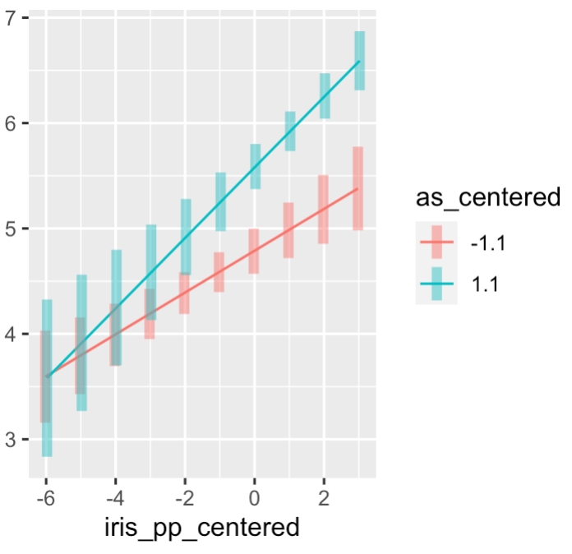
Parental
Autonomy
Support (AS)
Low AS
IER Effectiveness
High AS
IER Physical Presence

